Slide 1
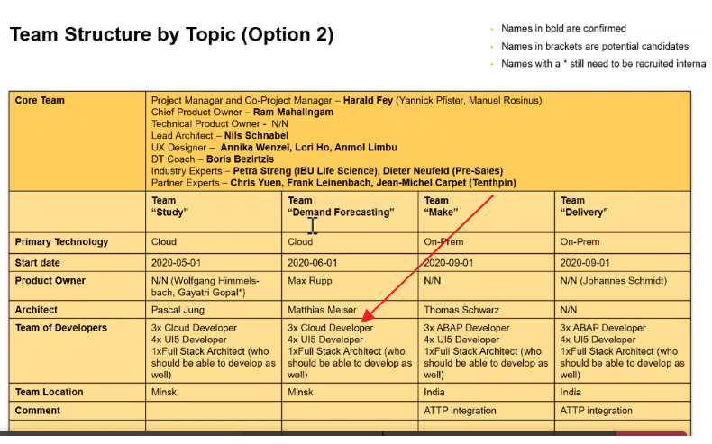

Slide 2

Scope Breakup
opt. for ODUs < 500 d, else mandatory
Overall judgement | Can SAP IBSO run this on its own concerning skills and experience? | Yes
Topic | SAP Component/ Solution | Technical Complexity | Architects of SAP IBSO Involved in estimates | Net Development Effort | SAP Solution Skills | Industry Expertise | Skills and experience generally available
Study Master | SAP Cloud Platform | Medium - High | Ram Mahalingam, Nils Schnabel, Maximillian Rupp, Pascal Jung, Thomas Schwartz | 1840 | Advanced | Advanced | Yes (IBSO,IBU, LeverX, Tenthpin)
Planning | SAP Cloud Platform | Medium - High | Same as Above | 1725 | Advanced | Advanced | Yes (IBSO,IBU, LeverX, Tenthpin)
Manufacturing | S/4 HANA Add-On | Medium - High | Same as above | 2415 | Advanced | Advanced | Yes (IBSO,IBU, LeverX, Tenthpin)
Deliver | S/4 HANA Add-On | Medium - High | Same as above | 1380 | Advanced | Advanced | Yes (IBSO,IBU, LeverX, Tenthpin)
 | SAP Component/ Solution | Techn. Complexity | Architect of SAP CD involved in estimate | Effort Range | SAP Solution Skills | Industry Expertise | Skills and experience generally available | Details/ Comments/ Assumptions
Handling and Storage | MM and WM | High/ Medium/Low | <Name> | 250-300 | [Expert, Advanced, or Basic] | [Expert, Advanced, or Basic] | [Yes, No, or Partially] – within CD, Consulting, 3rd party etc. | Text
Document Management | x |  | x | x | x | x | x | x
Permit Management | x |  | x | x | x | x | x | x
x | x |  | x | x | x | x | x | x
x | x |  | x | x | x | x | x | x

Slide 3










SAP Clinical Trial Supply Management
CLOUD
Firewall
ON-PREMISE
CTSM
Add-On
Advanced Track and Trace
Global Label Management
CTSM Fiori Applications
CTSM
Secure tunnel
Study Master
IRT
Cloud
Make
Cloud Connector
Sales and Distribution
Materials Management
CTMS
Cloud
Study Planning
Connectivity
SAP Cloud Platform Integration
IRT
On-Prem
Deliver
Project Systems
Production Planning
Portal
CTMS
On-Prem
Extended Warehouse Management
SAP Enterprise Messaging
SAP HANA service
Corporate Identity Provider

Slide 4
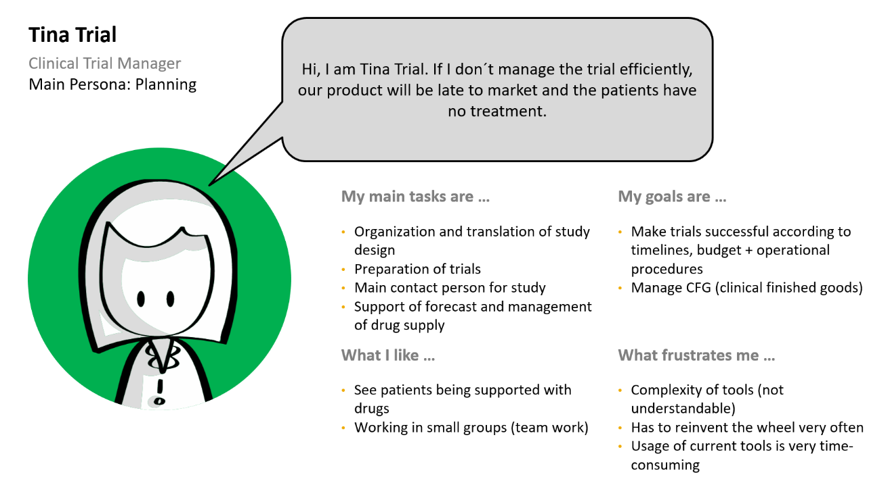
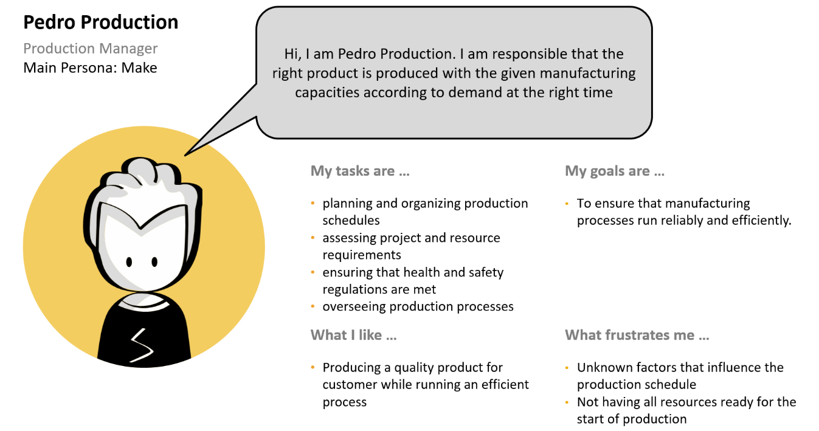
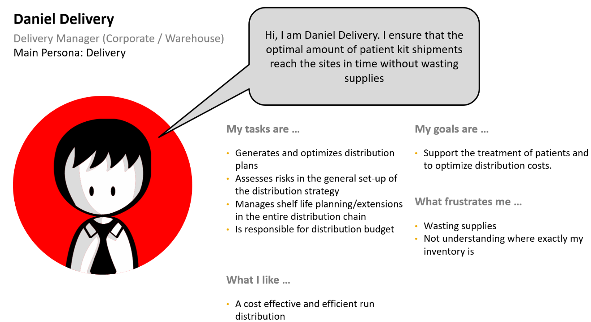
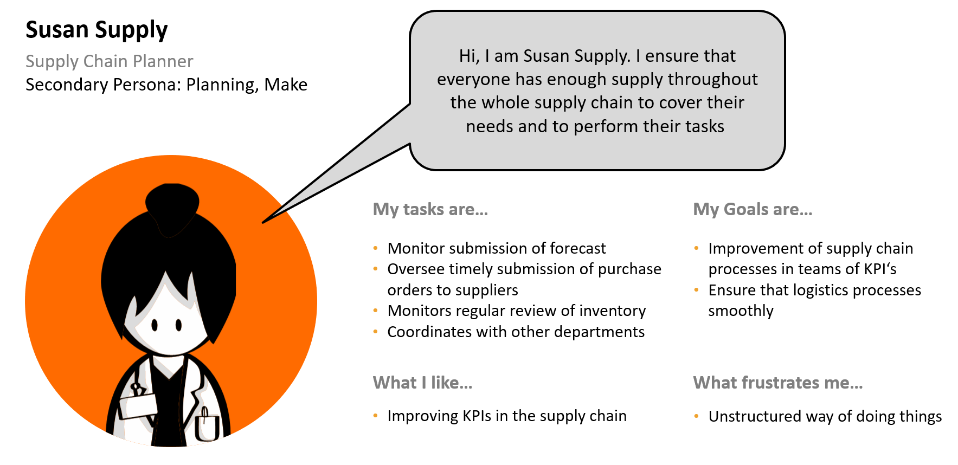

Slide 5
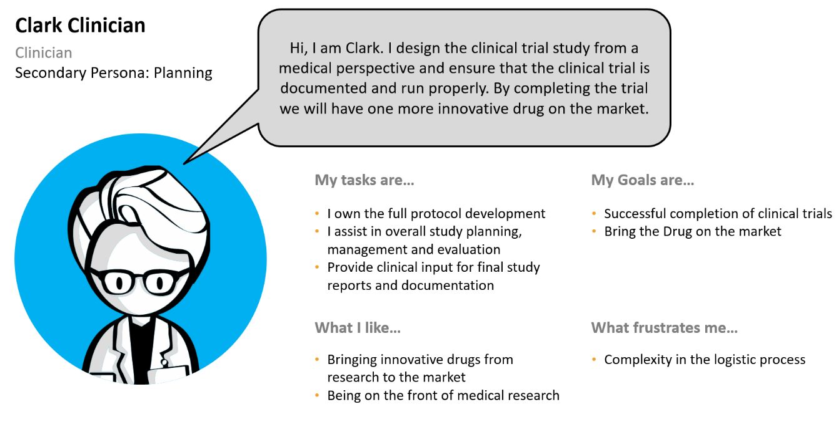
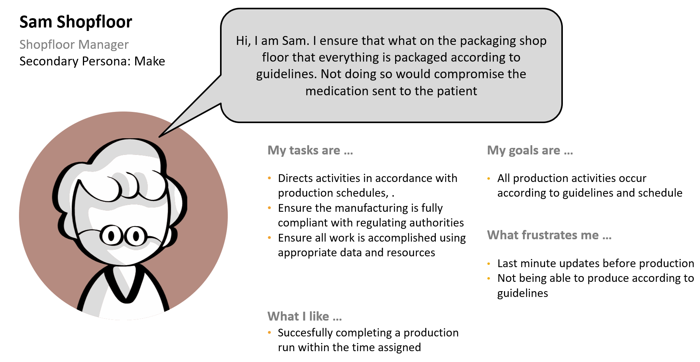
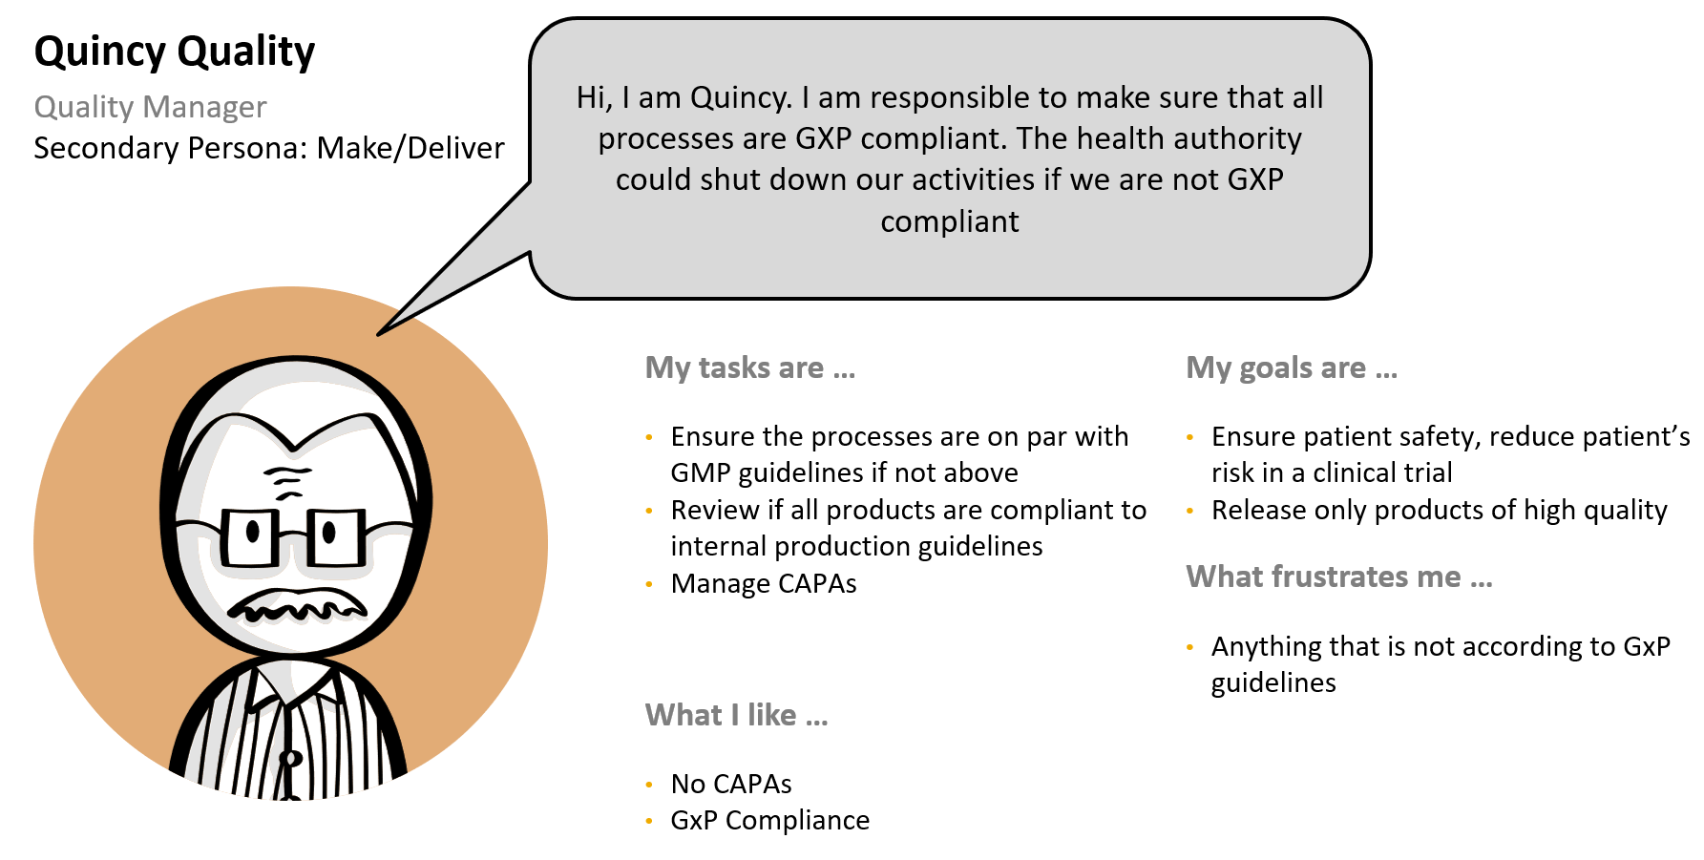
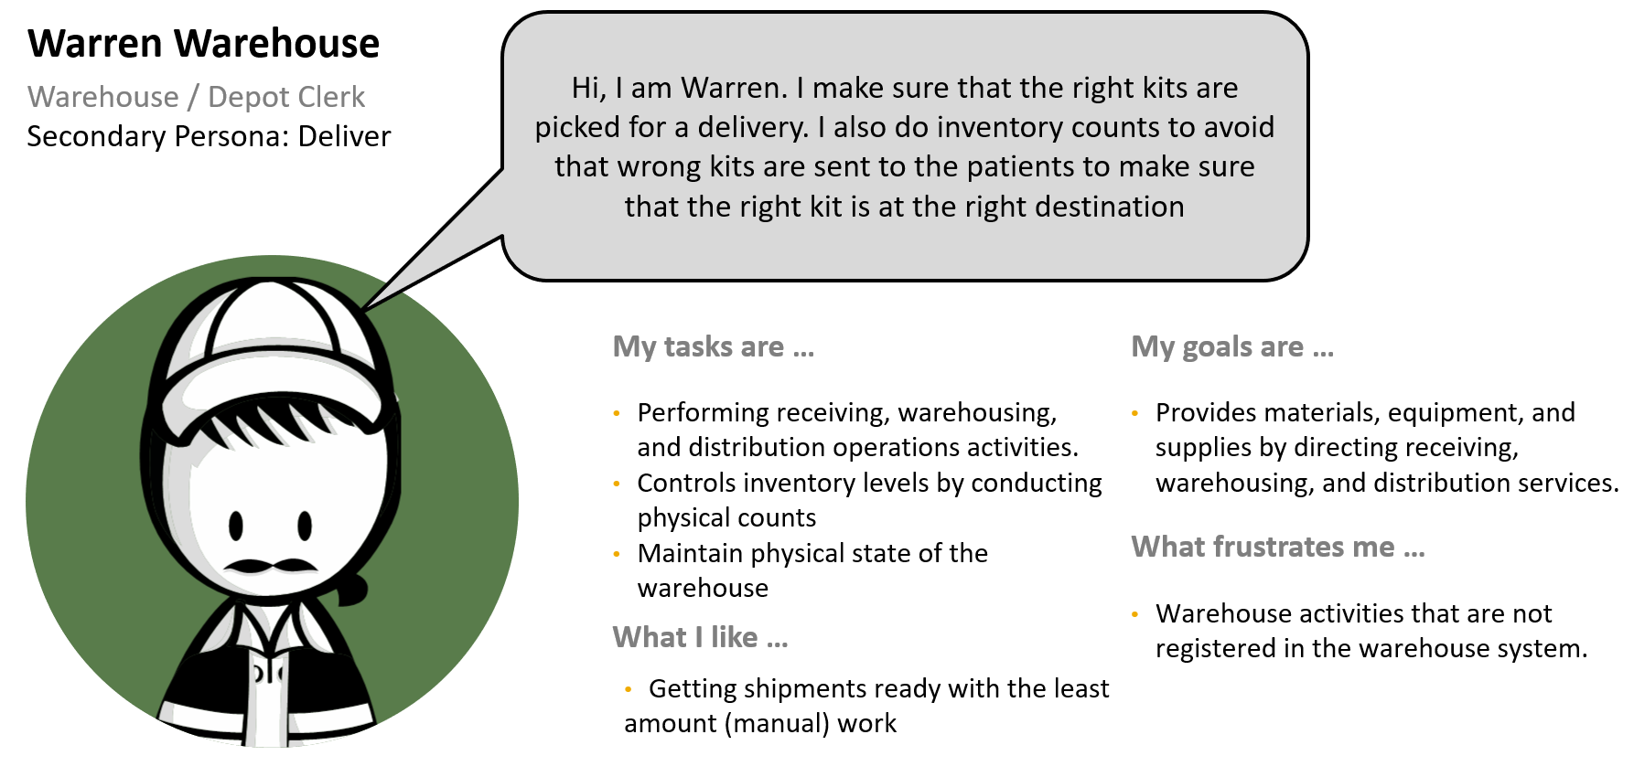

Slide 6
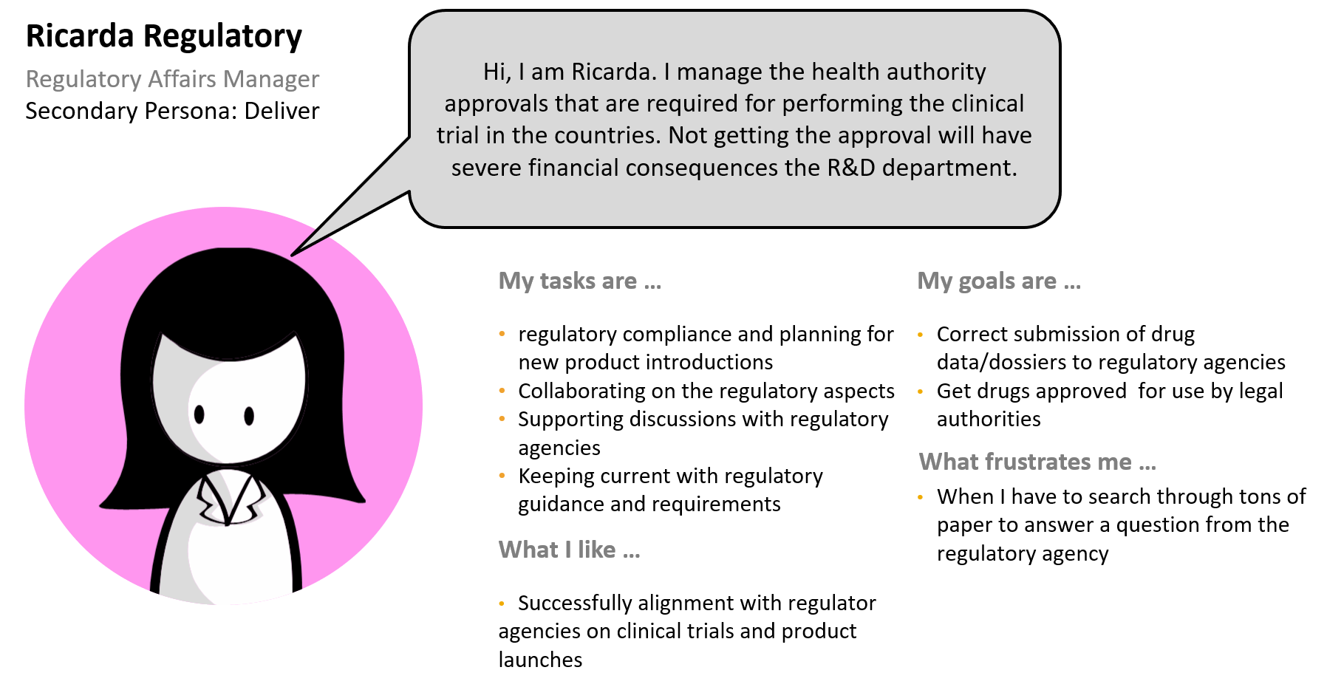
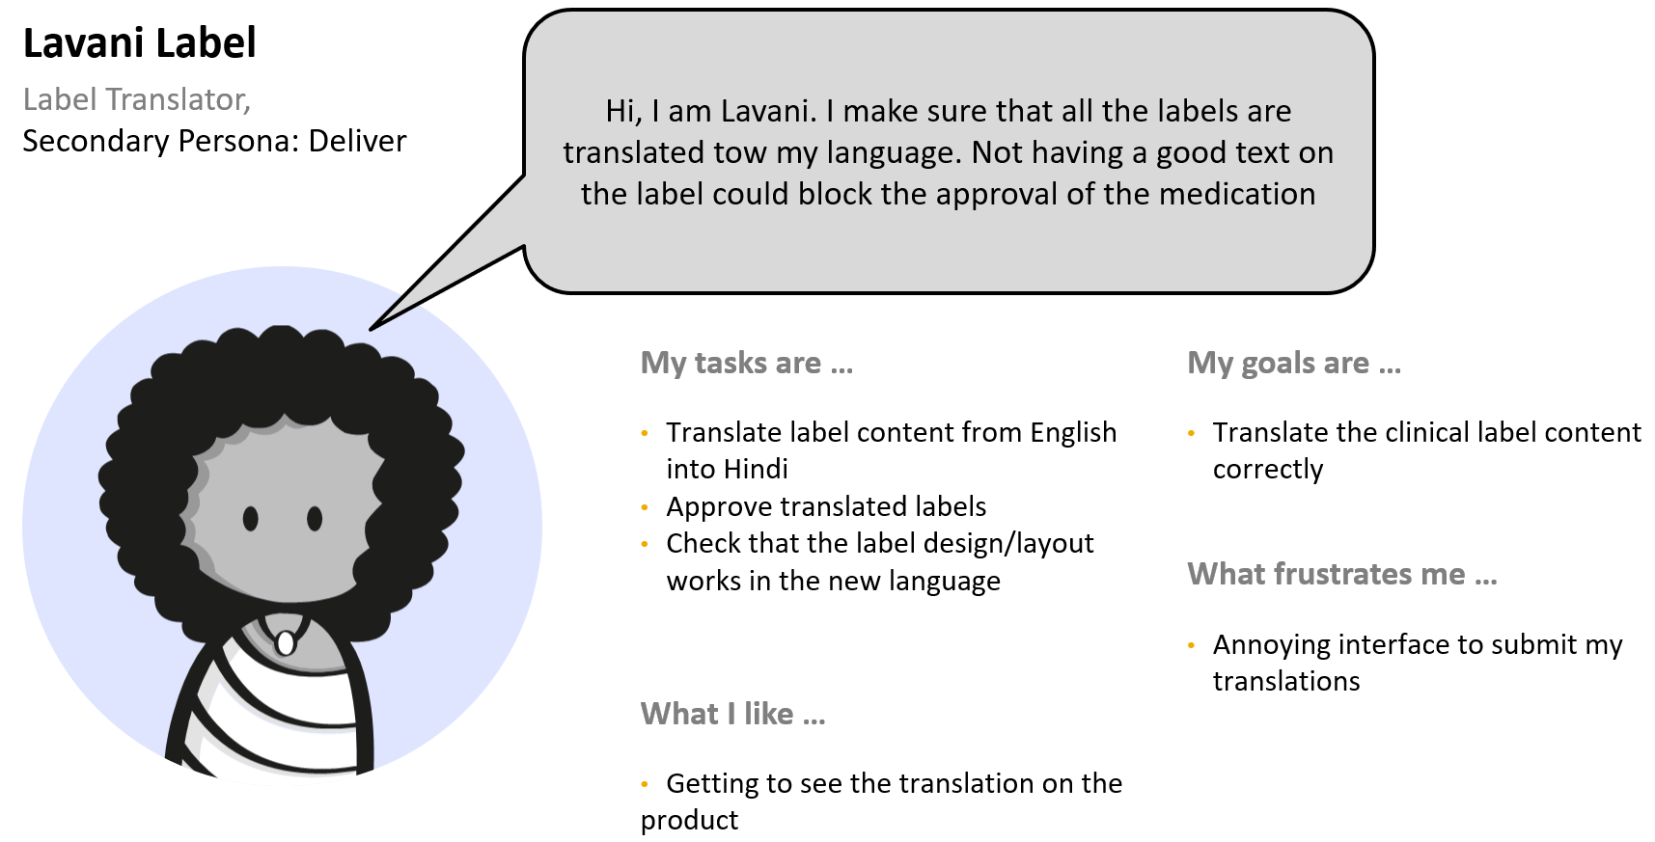
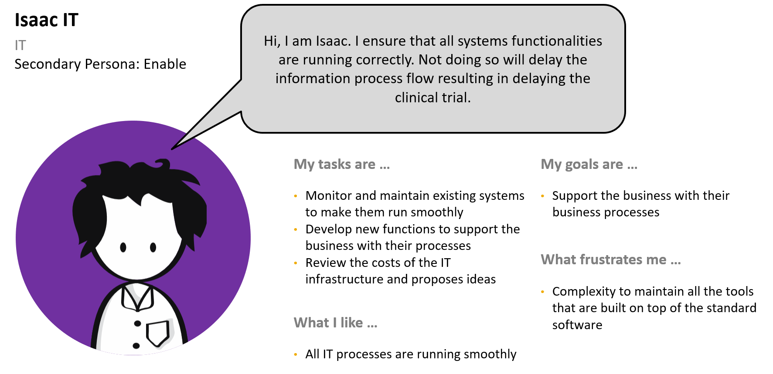

Slide 7
Process Flows
1. Planning
1. Plan
1.1 Trigger: Demand from clinician System CTMS
1.2 Definition of the drug substances (=compound)
1.3 Definition of trial (iterative) and simulations
1.4 Calculate and schedule demand
1.5 Approval of the protocol (paper)
1.6 Approval of study
1.7 Review Master Data
1.8 Push study design to IRT
1.9 Push demand to supply chain planning
2. Make
2. Make
2.1 Trigger
Planning for Trial is Executed
2.2 Checks validation summary for packaging
2.3 Release proposal for missing data
2.4 Review MRP results
2.5 Process Order preparation
2.6 Release Process Order
2.7 Order communication
2.8 Execution of packaging
2.9 Goods Receipt
3. Deliver
3. Deliver
3.1 Create STO based on Purchase Req
3.2 Create Outbound Delivery
3.3 Picking and post goods issues
3.4 Goods Receipt Delivery Local
3.5 Create Sales Order
3.6 Create Delivery
3.7 Pick & Post Goods Issues
3.8 Pro Forma Free of Charge Invoice
4. The Actual Trial
4. The Actual Trial
4.1 Patient visits the clinic
4.2 Pharmacist consults IRT on dispensation
4.3 Pharmacist prepare kit for the nurse
4.4 Nurse retrieves the kit for the patient
4.5 Pharmacist records dispensation
4.6 Nurse shows patient how to apply drugs
4.7 Patient applies drugs and record
4.8 Monitor patients health
4.9 Return drugs & ancillary supplies
5. Enable
5. Enable
5.1 System requires additional information
5.2 Information request sent out
5.3 Receiver notified on information request
5.4 Information request completed
5.5 Data is being validated
5.6 Information sent back
5.7 System process the required data
7
Notes:
Integrated Planning with Actuals: Actual figures from IRT on enrollment and visits.
Complex Product Environment: Pharmaceuticals and Bio-Pharmaceuticals, Cell Gene Therapies, Cold Chain, Cryogenic.
Cost and Risk Reduction: Planned Cost visibility, Analytics, Study Data Transparency.
Simulation Tool: Version Management, Forecast and demand simulations to optimize supply effeciencies while maintaining safety stock.
Intutive Study Design: Easy to understand UI and study design model to transfer the study to others.
Automated Replanning: Trigger Re-planning to reduce the workload for the Trial Manager after completion of enrollment phase.
Flexible Study Design: Allow System to model complex study designs in the system like Cohort and Tritration.
Rough Demand Planning: Ability to plan demand and supply without accurate data (e.g. material master).
Solution Highlights: Fiori UI, Version Management, Workflow, Excel Downloads, Status Management, 3rd Party Interfaces, User Enhancements, Configurations, Backend Logic, Copy Control, Rules Framework,

Slide 8
Timeline - Cloud Part (Wave 1)
2020
2021
J
F
M
A
M
J
J
A
S
O
N
D
J
F
M
A
M
J
Governance Council
Customer WS for Scoping Validation and Sign-off
Development Sprints (Wave 1)
Development Close and start of Integration tests (Wave 1)
Start of Productization
Release to Customer
Legend:
Duration
Milestone
Signature expected
8

Slide 9
Timeline - Cloud Part (Wave 2)
2021
2022
J
F
M
A
M
J
J
A
S
O
N
D
J
F
M
A
M
J
Customer WS* for Scoping Validation and Sign-off
Development Sprints (Wave 2)
Development Close and start of Integration tests (Wave 2)
Start of Productization
Release to Customer
Legend:
Duration
Milestone
* Customer workshops may start in Q4 2020 for Wave 2
9

Slide 10
Timeline – S/4 HANA On Premise Add-ON
2020
2021
J
F
M
A
M
J
J
A
S
O
N
D
J
F
M
A
M
J
Governance Council
Customer WS for Scoping Validation and Sign-off
Development Sprints
Legend:
Duration
Milestone
Signature expected
10

Slide 11
Timeline - S/4 HANA On Premise Add-ON
2021
2022
J
F
M
A
M
J
J
A
S
O
N
D
J
F
M
A
M
J
Customer WS for Scoping Validation and Sign-off
Development Sprints
Development Close and start of Integration tests
Start of Productization
Release to Customer
Legend:
Duration
Milestone
11

Slide 12
Project Organization and Project Team Staffing
Lead Organizations | Market Unit | SAP Switzerland
 | SAP IBSO region | EMEA
Key contacts | SAP Account | Alex Abawi
 | Customer | Mark Unter
 | Partner | Michael Schmidt (Tenthpin)
Project Team | Accountable Engineering Manager | Katrina Simon
 | Product Owner | Ram Mahalingam
 | Scrum Master | Harald Fey
 | Project Manager | Harald Fey
Development Teams | Architect | Nils Schnabel (Lead Development Architect)
 | UX Design | Annika Wenzel
 | User Assistance & Translation | Geetanjali Ram
 | Quality Management | Michael Koehl
 | DT Coach | Boris Bezirtzis
Alignments | Staffing agreed with respective delivery location head(s)? | Yes
 | Methodology Approach | External Scrum

